Slide 1
Comparing NoSQL and SQL
A presentation comparing NoSQL databases, specifically MongoDB, and SQL databases.

Slide 2

Introduction
01
SQL databases
Is a type of database that uses Structured Query Language (SQL) for defining, manipulating, and querying data.
SQL databases are also known as relational databases because they organize data into tables with rows and columns, where each table represents a different entity and relationships between these entities are established through keys.

Slide 3
Introduction
02
MongoDB
Is a popular NoSQL database designed for handling large volumes of data with a flexible, scalabe, and high-performance approach approach.
Unlike traditional SQL databases, MongoDB uses a document-oriented data model, which allows for more flexible data structures.

Slide 4
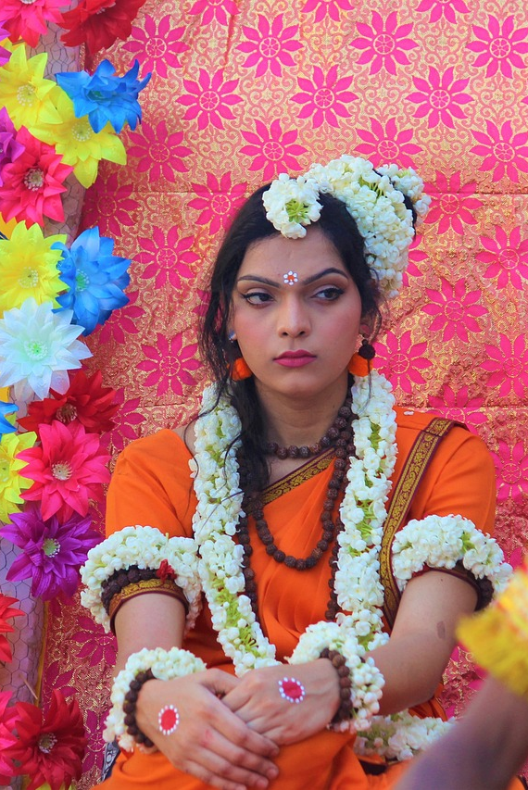
Scalability
SQL databases
Traditional SQL databases primarily scale vertically by upgrading the existing hardware(CPU, RAM, storage) to cope with increased demand.
MongoDB
Horizontal scalability: MongoDB is designed for horizontal scalability, allowing data to be distributed across multiple servers or clusters. This is achieved via sharding.

Slide 5

Data Model
SQL databases
Relational Model: Uses tables with predefined schemas, rows and columns. The data is normalized to reduce redundancy and maintain data integrity.
They require a defined schema before inserting data, which enforces structure and consistency.
MongoDB
Is document-oriented and uses BSON for data storage, allowing for more flexible, intuitive data structures.
Is “schema-less” , allowing for a varied data model.

Slide 6

Querying
SQL databases
Use the powerful and standardized SQL language, which is well-known and widely used.
MongoDB
Uses BSON, which is a rich query language that supports complex queries, aggregation and indexing.
BSON is also more intuitive for developers familiar with JSON.

Slide 7

Use Cases
SQL databases
Content Management Systems
Mobile and Web Apps
Real-time Analytics
MongoDB
Financial Systems
E-Commerce Platforms
Enterprise Applications

Slide 8
Thank you! 😄
© 2024 Raymond Wambu

